Slide 1





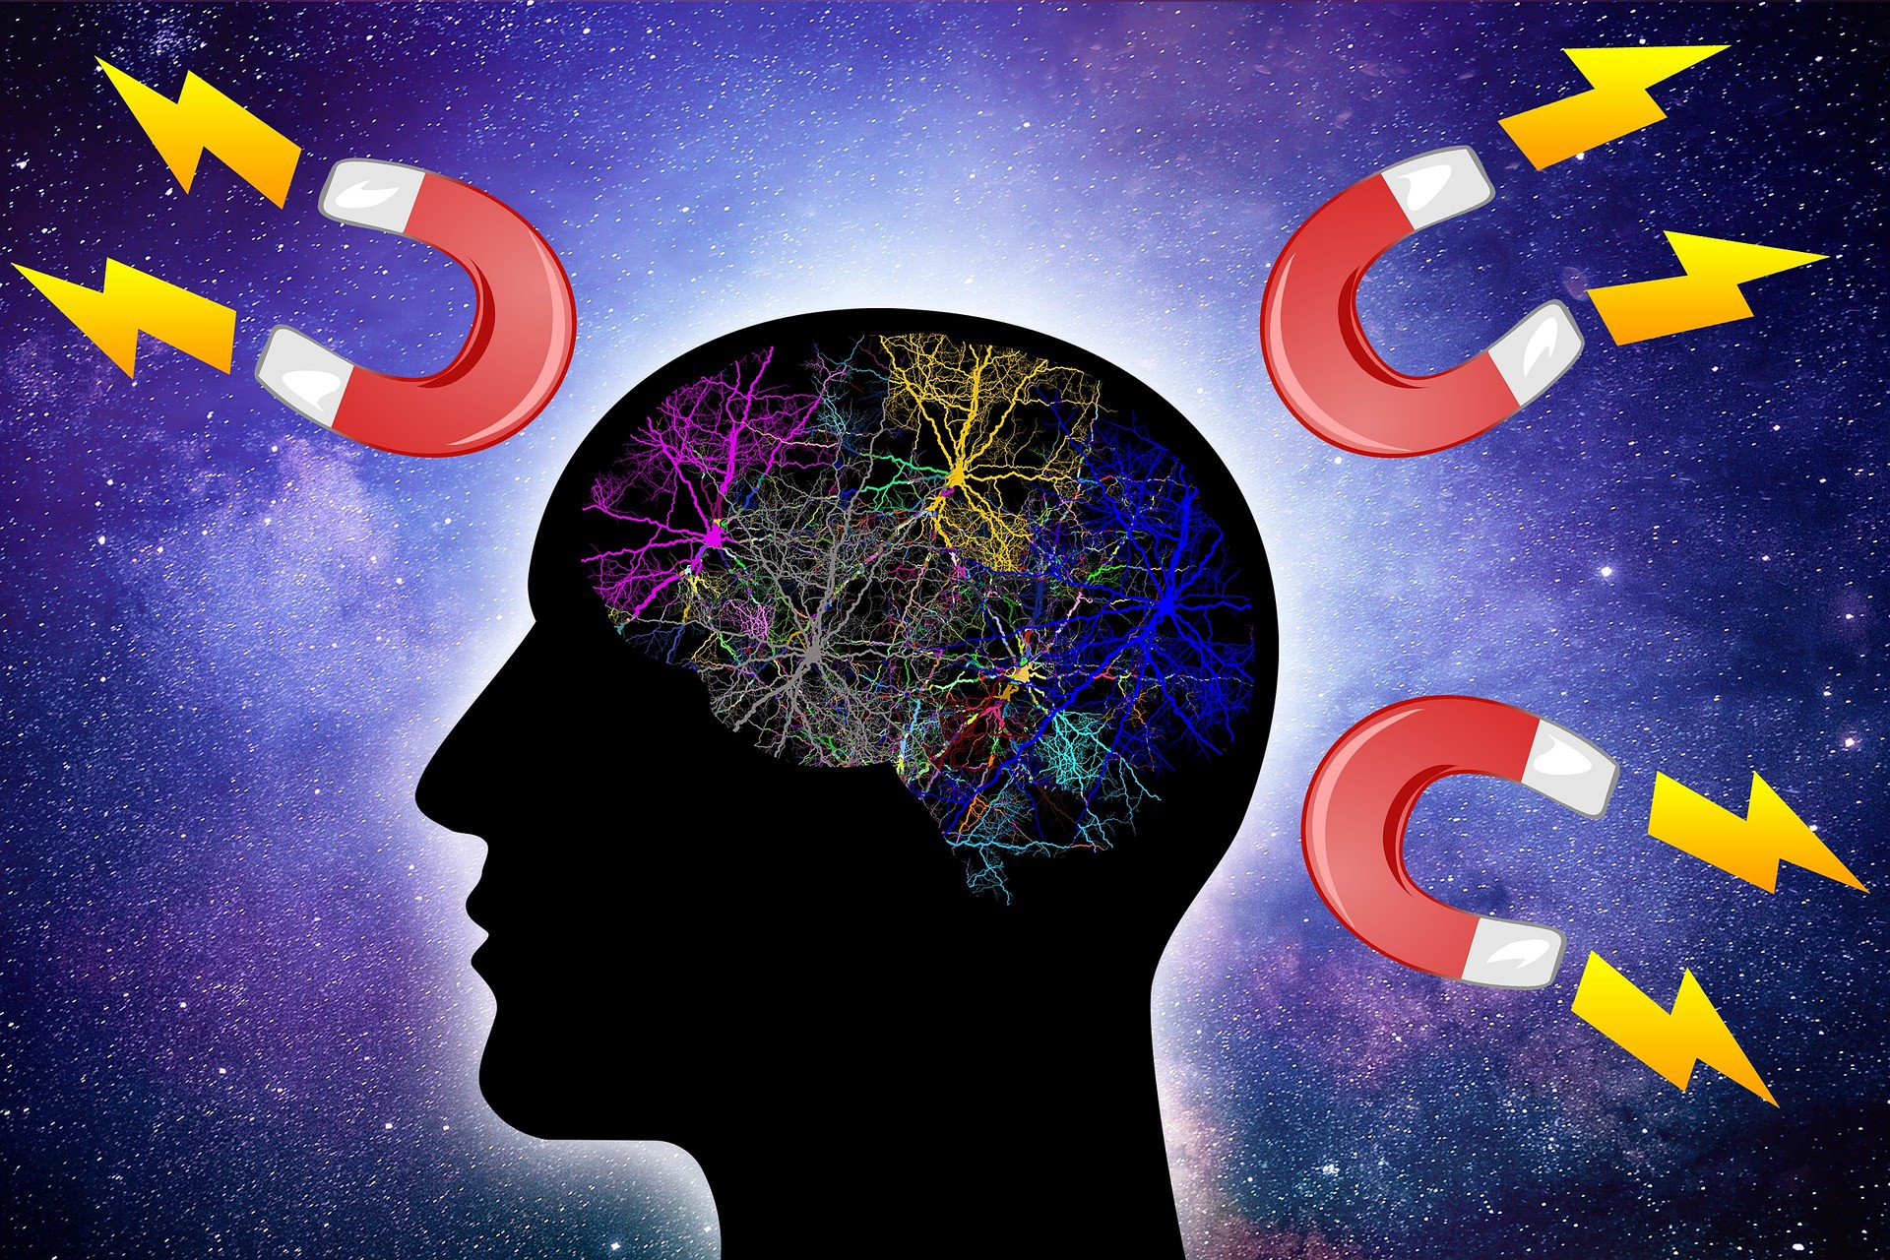
Presentation By:
Rajneesh Pandey
106119100

